Slide 1
Comparison of PDH and SONET/SDH

Slide 2
plesiochronous digital hierarchy (PDH)
asynchronous digital hierarchy
In asynchronous multiplexing, each terminal in the network runs its own clock, when lower-speed streams are multiplexed by interleaving their bits, extra bits may need to be stuffed in the multiplexed stream to account for differences between the clockrates of the individual streams. As a result, the bit rates in the asynchronous
hierarchy are not integral multiples of the basic 64 kb/s ratebut rather slightly higher to account for this bit stuffing.

Slide 3
asynchronous digital hierarchy
With asynchronous multiplexing, it is very difficult to pick out a low-bit-rate stream, say, at 64 kb/s, from a higher-speed stream passing through, say, a DS3 stream, without completely demultiplexing the higher-speed stream down to its individual component streams. This results in the need for "multiplexer mountains,” or stacked-up multiplexers, each time a low-bit-rate stream needs to be extracted.

Slide 4
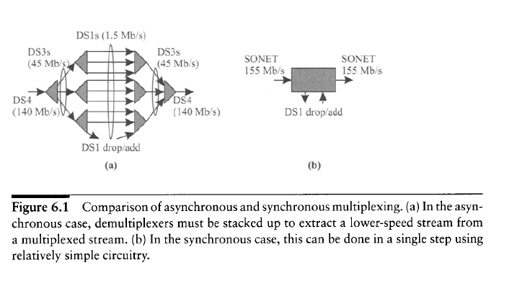

Slide 5
Management:
The SONET and SDH standards incorporate extensive management information for managing the network, including extensive performance
monitoring, identification of connectivity and traffic type, identification and reporting of failures, and a data communication channel for transporting management information between the nodes. This is mostly lacking in the PDH
standards.

Slide 6
Interoperability:
Although PDH defined multiplexing methods, it did not define a standard format on the transmission link.
Thus different vendors used differentline coding, optical interfaces, and so forth to optimize their products,which made it very difficult to connect one vendor's equipment to another's via a transmission link.
SONET and SDH avoid this problem by defining standard optical interfaces that enable interoperability between equipment from different vendors on the link.

Slide 7
Network availability:
The SONET and SDH standards have evolved to incorporate specific network topologies and specific protection techniques and associated
protocols to provide high-availability services.
restoration time after a failure with SONET and SDH is much smallermless than 60 ms than the restoration time in PDH networks, which typically took several seconds to minutes.
.

